Slide 1
Introduction to Data Science
Subject Code: CSDS7001
Dr. Sanoj Kumar School of Computer Science
University of Petroleum and Energy Studies, Dehradun
Email id: sanoj.kumar@ddn.upes.ac.in
Mb. Num.: 9058523010

Slide 2
Handling Numeric Data
1. Discretization:
Definition: Discretization is the process of transforming continuous numeric variables into discrete categories or bins.
Purpose:
Simplify analysis by reducing the number of unique values.
Prepare data for techniques that work better with categorical variables.
Methods:
Equal Width Binning: Divide the range of values into equal-sized bins.
Equal Frequency Binning: Divide the data into bins with an equal number of observations in each bin.
Custom Binning: Create bins based on domain knowledge or specific requirements.
Example:
Age Discretization: Grouping ages into categories like 'Child,' 'Adult,' and 'Senior.'

Slide 3
2. Binarization:
Definition: Binarization is the process of transforming numeric data into binary values (0 or 1) based on a threshold.
Purpose:
Simplify analysis by converting numerical values into a binary format.
Suitable for algorithms that require binary input.
Methods:
Simple Thresholding: Values above the threshold become 1, and below or equal become 0.
Adaptive Thresholding: Adjust the threshold dynamically based on local properties of the data.
Example:
Converting grayscale image pixels to black (0) or white (1) based on intensity threshold.

Slide 4
3. Normalization:
Definition: Normalization is the process of scaling numerical features to a standard range, typically [0, 1] or [-1, 1].
Purpose:
Ensure all features contribute equally to the analysis.
Avoid dominance of one feature due to its larger magnitude.
Methods:
Min-Max Scaling: Scale data to a specified range using the minimum and maximum values.
Z-Score Standardization: Transform data to have a mean of 0 and a standard deviation of 1.
Example:
Scaling exam scores (ranging from 0 to 100) to [0, 1] for uniform comparison.

Slide 5
4. Data Smoothing:
Definition: Data smoothing is the process of removing noise or irregularities from a dataset to reveal underlying patterns.
Purpose:
Enhance signal-to-noise ratio for better analysis.
Make data more interpretable by reducing complexity.
Methods:
Moving Averages: Replace each data point with the average of neighboring points.
Gaussian Smoothing: Convolve the data with a Gaussian kernel to reduce noise.
Examples:
Smoothing a stock price time series to visualize trends by applying a moving average.
Measurement of environmental temperature fluctuates due to various factors, causing unwanted noise in the dataset.
Quarterly sales data for a retail store displays fluctuating trends over time.
A biomedical signal (e.g., ECG) contains noise due to electrical interference. (Savitzky-Golay Smoothing)

Slide 6
Handling Different Types of Data

Slide 7
1. Dealing with Textual Data:
Preprocessing Text Data:
Tokenization: Breaking text into smaller units (words, phrases, symbols) known as tokens.
Stopword Removal: Removing common words (e.g., 'and', 'the') that carry little information.
Stemming and Lemmatization: Reducing words to their root form (e.g., 'running' to 'run').
Normalization: Converting text to a standard format (e.g., lowercase).
Text Vectorization:
Bag of Words (BoW): Represent text as a matrix of word counts.
Term Frequency-Inverse Document Frequency (TF-IDF): Assign weights to words based on their importance in a document relative to a corpus.
Word Embeddings: Represent words as dense vectors capturing semantic relationships (e.g., Word2Vec, GloVe).
Text Analysis:
Sentiment Analysis: Determine the sentiment (positive, negative, neutral) of text.
Topic Modeling: Identify key topics within a collection of documents (e.g., Latent Dirichlet Allocation, LDA).

Slide 8
2. Dealing with Images:
Preprocessing Image Data:
Resizing and Cropping: Adjusting images to a standard size for consistency.
Normalization: Scaling pixel values to a specific range (e.g., [0, 1]).
Data Augmentation: Generating additional training data by applying transformations like rotation, zoom, or flipping.

Slide 9
3. Dealing with Audio:
Preprocessing Audio Data:
Resampling: Standardizing the sampling rate for consistency.
Spectral Analysis: Transforming audio signals into frequency-domain representations (e.g., spectrograms).
Mel-Frequency Cepstral Coefficients (MFCCs): Extracting features for audio analysis.
Recurrent Neural Networks (RNNs):
Architecture: RNNs are used for sequential data like audio and text.
Applications: Speech recognition, language modeling.

Slide 10
4. Dealing with Video:
Preprocessing Video Data:
Frame Sampling: Extracting frames at a fixed interval to reduce data size.
Video to Images: Converting videos into a sequence of images for analysis.
Frame Preprocessing: Apply image preprocessing techniques to video frames.
Video Analysis:
Action Recognition: Identify actions or movements in video sequences.
Object Detection: Detect and track objects within video frames.
Optical Flow: Analysing motion between frames for action recognition.

Slide 11
5. Managing Categorical Attributes:
Encoding Categorical Data:
One-Hot Encoding: Create binary columns for each category.
Label Encoding: Assign a unique integer to each category.
Embedding: Map categorical variables to continuous vectors.
Dealing with High Cardinality:
Feature Engineering: Aggregate or transform categorical variables to reduce dimensionality.
Frequency-Based Encoding: Encode categories based on their frequency in the dataset.
Handling Ordinal Data:
Ordinal Encoding: Assign integers to categories based on their inherent order.
Custom Encoding: Create custom mapping functions for ordinal attributes.

Slide 12
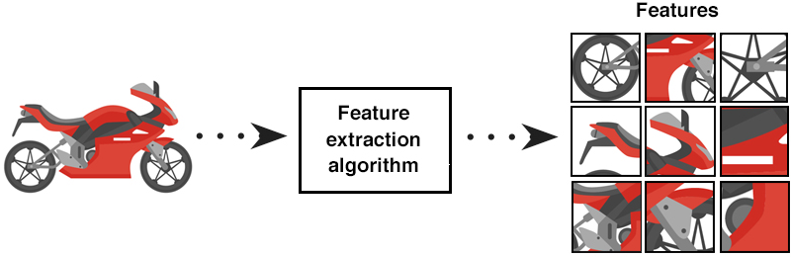
Unit 3: Feature Engineering
Feature Extraction:
Definition: Feature extraction is the process of selecting and transforming the most relevant information or features from raw data. These features are designed to capture essential patterns or characteristics of the data that are useful for a particular task.
Purpose: Feature extraction reduces the dimensionality of the data, improves computational efficiency, and often enhances the performance of machine learning models. It helps in focusing on the most important aspects of the data.

Slide 13
Feature extraction in data science involves selecting and transforming relevant information from raw data to create a set of meaningful features for analysis or machine learning. Here are examples and methods of feature extraction:
1. Text Data:
Methods:
Bag of Words (BoW): Converts text documents into a matrix of word frequencies.
Term Frequency-Inverse Document Frequency (TF-IDF): Measures the importance of words in a document within a collection.
Word Embeddings (e.g., Word2Vec, GloVe): Transform words into dense vector representations.
Example: In natural language processing, BoW can be used to extract features from text for tasks like sentiment analysis.

Slide 14
2. Image Data:
Methods:
Color Histograms: Describes the distribution of pixel colors in an image.
Edge Detection (e.g., using Canny or Sobel operators): Extracts edge features.
Convolutional Neural Networks (CNNs): Automatically learn features at various levels of abstraction.
Example: In image recognition, CNNs are used to extract features from images, which are then used to train classifiers.
3. Audio Data:
Methods:
Mel-Frequency Cepstral Coefficients (MFCCs): Captures spectral characteristics of audio signals.
Chroma Features: Describe pitch and harmony information.
Wavelet Transform: Represents audio data in time-frequency space.
Example: In speech recognition, MFCCs are commonly used for feature extraction.

Slide 15
4. Time Series Data:
Methods:
Statistical Features (e.g., mean, variance, skewness): Summarize data distribution.
Fourier Transform: Converts data into its frequency components.
Wavelet Transform: Reveals patterns at different scales.
Example: In financial analysis, statistical features can be extracted from time series data to predict stock prices.
5. Geospatial Data:
Methods:
Distance Metrics: Calculate distances between geographic points.
Density-Based Features: Measure population density, proximity to resources, etc.
Spatial Aggregations: Summarize data within geographic regions.
Example: In urban planning, features like proximity to public transport or green spaces can be extracted for analysis.

Slide 16
6. Tabular Data:
Methods:
Principal Component Analysis (PCA): Reduces dimensionality by finding orthogonal components.
Feature Scaling: Standardizes features to have similar scales.
Feature Engineering: Creating new features from existing ones.
Example: In customer segmentation, PCA can be applied to reduce the dimensionality of customer data.

Slide 17
1. The need for Dimensionality Reduction
In real-world machine learning problems, there are often too many factors (features) on the basis of which the final prediction is done. The higher the number of features, the harder it gets to visualize the training set and then work on it. Sometimes, many of these features are correlated or redundant. This is where dimensionality reduction algorithms come into play.
2. What is Dimensionality reduction
Dimensionality reduction is the process of reducing the number of random features under consideration, by obtaining a set of principal or important features.
Dimensionality reduction can be done in 2 ways:
a. Feature Selection: By only keeping the most relevant variables from the original dataset
Correlation
Forward Selection
Backward Elimination
Select K Best
Missing value Ratio

Slide 18
b. Feature Extraction: By finding a smaller set of new variables, each being a combination of the input variables, containing basically the same information as the input variables.
PCA (Principal Component Analysis)
LDA (Linear Discriminant Analysis)
The feature Extraction technique gives us new features which are a linear combination of the existing features. The new set of features will have different values as compared to the original feature values. The main aim is that fewer features will be required to capture the same information. We might think that choosing fewer features might lead to underfitting but in the case of the Feature Extraction technique, the extra data is generally noise.

Slide 19
3. PCA(Principal Component Analysis)
In simple words, PCA is a method of obtaining important variables (in form of components) from a large set of variables available in a data set. It tends to find the direction of maximum variation (spread) in data. PCA is more useful when dealing with 3 or higher-dimensional data.
PCA can be used for anomaly detection and outlier detection because they will not be part of the data as it would be considered noise by PCA.
Standardize the data (X_std)
Calculate the Covariance-matrix
Calculate the Eigenvector & Eigenvalues for the Covariance-matrix.
Arrange all Eigenvalues in decreasing order.
Normalize the sorted Eigenvalues.
Horizontally stack the Normalized_ Eigenvalues =W_matrix
X_PCA=X_std .dot (W_matrix)

Slide 20
HOW DO YOU DO A PRINCIPAL COMPONENT ANALYSIS?
Standardize the range of continuous initial variables
Compute the covariance matrix to identify correlations
Compute the eigenvectors and eigenvalues of the covariance matrix to identify the principal components
Create a feature vector to decide which principal components to keep
Recast the data along the principal components axes

Slide 21
What Is Principal Component Analysis?
Principal component analysis, or PCA, is a dimensionality reduction method that is often used to reduce the dimensionality of large data sets, by transforming a large set of variables into a smaller one that still contains most of the information in the large set.
Reducing the number of variables of a data set naturally comes at the expense of accuracy, but the trick in dimensionality reduction is to trade a little accuracy for simplicity. Because smaller data sets are easier to explore and visualize and make analyzing data points much easier and faster for machine learning algorithms without extraneous variables to process.
So, to sum up, the idea of PCA is simple — reduce the number of variables of a data set, while preserving as much information as possible.

Slide 22

Step-by-Step Explanation of PCA
STEP 1: STANDARDIZATION
The aim of this step is to standardize the range of the continuous initial variables so that each one of them contributes equally to the analysis. More specifically, the reason why it is critical to perform standardization prior to PCA, is that the latter is quite sensitive regarding the variances of the initial variables. That is, if there are large differences between the ranges of initial variables, those variables with larger ranges will dominate over those with small ranges (for example, a variable that ranges between 0 and 100 will dominate over a variable that ranges between 0 and 1), which will lead to biased results. So, transforming the data to comparable scales can prevent this problem.
Mathematically, this can be done by subtracting the mean and dividing by the standard deviation for each value of each variable.
Once the standardization is done, all the variables will be transformed to the same scale.

Slide 23



STEP 2: COVARIANCE MATRIX COMPUTATION
The aim of this step is to understand how the variables of the input data set are varying from the mean with respect to each other, or in other words, to see if there is any relationship between them. Because sometimes, variables are highly correlated in such a way that they contain redundant information. So, in order to identify these correlations, we compute the covariance matrix.
The covariance matrix is a p × p symmetric matrix (where p is the number of dimensions) that has as entries the covariances associated with all possible pairs of the initial variables. For example, for a 3-dimensional data set with 3 variables x, y, and z, the covariance matrix is a 3×3 data matrix of this from:
$$Cov\left(x,y\right)= \frac{1}{N}\sum{\left(x −\overline{x}\right)\left(y −\overline{y}\right)}$$
For Population
$$Cov\left(x,y\right)= \frac{1}{N−1}\sum{\left(x −\overline{x}\right)\left(y −\overline{y}\right)}$$
For Sample

Slide 24
Since the covariance of a variable with itself is its variance (Cov(a,a)=Var(a)), in the main diagonal (Top left to bottom right) we actually have the variances of each initial variable. And since the covariance is commutative (Cov(a,b)=Cov(b,a)), the entries of the covariance matrix are symmetric with respect to the main diagonal, which means that the upper and the lower triangular portions are equal.
What do the covariances that we have as entries of the matrix tell us about the correlations between the variables?
It’s actually the sign of the covariance that matters:
If positive then: the two variables increase or decrease together (correlated)
If negative then: one increases when the other decreases (Inversely correlated)
Now that we know that the covariance matrix is not more than a table that summarizes the correlations between all the possible pairs of variables, let’s move to the next step.

Slide 25
STEP 3: COMPUTE THE EIGENVECTORS AND EIGENVALUES OF THE COVARIANCE MATRIX TO IDENTIFY THE PRINCIPAL COMPONENTS
Eigenvectors and eigenvalues are the linear algebra concepts that we need to compute from the covariance matrix in order to determine the principal components of the data. Before getting to the explanation of these concepts, let’s first understand what do we mean by principal components.
Principal components are new variables that are constructed as linear combinations or mixtures of the initial variables. These combinations are done in such a way that the new variables (i.e., principal components) are uncorrelated and most of the information within the initial variables is squeezed or compressed into the first components. So, the idea is 10-dimensional data gives you 10 principal components, but PCA tries to put maximum possible information in the first component, then maximum remaining information in the second and so on, until having something like shown in the scree plot below.

Slide 26
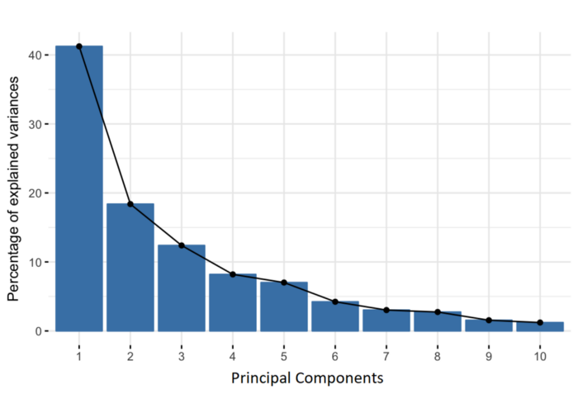

Slide 27
Organizing information in principal components this way, will allow you to reduce dimensionality without losing much information, and this by discarding the components with low information and considering the remaining components as your new variables.
An important thing to realize here is that the principal components are less interpretable and don’t have any real meaning since they are constructed as linear combinations of the initial variables.
Geometrically speaking, principal components represent the directions of the data that explain a maximal amount of variance, that is to say, the lines that capture most information of the data. The relationship between variance and information here, is that, the larger the variance carried by a line, the larger the dispersion of the data points along it, and the larger the dispersion along a line, the more information it has. To put all this simply, just think of principal components as new axes that provide the best angle to see and evaluate the data, so that the differences between the observations are better visible.

Slide 28
How PCA Constructs the Principal Components
As there are as many principal components as there are variables in the data, principal components are constructed in such a manner that the first principal component accounts for the largest possible variance in the data set.
For example, let’s assume that the scatter plot of our data set is as shown below, can we guess the first principal component ?
Yes, it’s approximately the line that matches the purple marks because it goes through the origin and it’s the line in which the projection of the points (red dots) is the most spread out.
Or, mathematically speaking, it’s the line that maximizes the variance (the average of the squared distances from the projected points (red dots) to the origin).

Slide 29
The second principal component is calculated in the same way, with the condition that it is uncorrelated with (i.e., perpendicular to) the first principal component and that it accounts for the next highest variance.

Slide 30
This continues until a total of p principal components have been calculated, equal to the original number of variables.
Now that we understand what we mean by principal components, let’s go back to eigenvectors and eigenvalues. What you first need to know about them is that they always come in pairs, so that every eigenvector has an eigenvalue. And their number is equal to the number of dimensions of the data. For example, for a 3-dimensional data set, there are 3 variables, therefore there are 3 eigenvectors with 3 corresponding eigenvalues.
Without further ado, it is eigenvectors and eigenvalues who are behind all the magic explained above, because the eigenvectors of the Covariance matrix are actually the directions of the axes where there is the most variance (most information) and that we call Principal Components. And eigenvalues are simply the coefficients attached to eigenvectors, which give the amount of variance carried in each Principal Component.

Slide 31
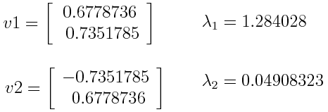
By ranking your eigenvectors in order of their eigenvalues, highest to lowest, you get the principal components in order of significance.
Principal Component Analysis Example:
Let’s suppose that our data set is 2-dimensional with 2 variables x, y and that the eigenvectors and eigenvalues of the covariance matrix are as follows:
If we rank the eigenvalues in descending order, we get λ1 > λ2, which means that the eigenvector that corresponds to the first principal component (PC1) is v₁ and the one that corresponds to the second principal component (PC2) is v₂ .

Slide 32
After having the principal components, to compute the percentage of variance (information) accounted for by each component, we divide the eigenvalue of each component by the sum of eigenvalues. If we apply this on the example above, we find that PC1 and PC2 carry respectively 96 percent and 4 percent of the variance of the data.
STEP 4: FEATURE VECTOR
As we saw in the previous step, computing the eigenvectors and ordering them by their eigenvalues in descending order, allow us to find the principal components in order of significance. In this step, what we do is, to choose whether to keep all these components or discard those of lesser significance (of low eigenvalues), and form with the remaining ones a matrix of vectors that we call Feature vector.
So, the feature vector is simply a matrix that has as columns the eigenvectors of the components that we decide to keep. This makes it the first step towards dimensionality reduction, because if we choose to keep only p eigenvectors (components) out of n, the final data set will have only p dimensions.

Slide 33


Principal Component Analysis Example:
Continuing with the example from the previous step, we can either form a feature vector with both of the eigenvectors v₁ and v₂ :
Or discard the eigenvector v₂ , which is the one of lesser significance, and form a feature vector with v₁ only:
Discarding the eigenvector v₂ will reduce dimensionality by 1 and will consequently cause a loss of information in the final data set. But given that v₂ was carrying only 4 percent of the information, the loss will be therefore not so important and we will still have 96 percent of the information that is carried by v₁.

Slide 34
So, as we saw in the example, it’s up to you to choose whether to keep all the components or discard the ones of lesser significance, depending on what you are looking for. Because if you just want to describe your data in terms of new variables (principal components) that are uncorrelated without seeking to reduce dimensionality, leaving out lesser significant components is not needed.
STEP 5: RECAST THE DATA ALONG THE PRINCIPAL COMPONENTS AXES
In the previous steps, apart from standardization, you do not make any changes on the data, you just select the principal components and form the feature vector, but the input data set remains always in terms of the original axes (i.e, in terms of the initial variables).
In this step, which is the last one, the aim is to use the feature vector formed using the eigenvectors of the covariance matrix, to reorient the data from the original axes to the ones represented by the principal components (hence the name Principal Components Analysis). This can be done by multiplying the transpose of the original data set by the transpose of the feature vector.

Slide 35
Feature Engineering
Feature engineering is the process of selecting, manipulating, and transforming raw data into features that can be used in machine learning techniques. In order to make machine learning work well on new tasks, it might be necessary to design and train better features. As you may know, a “feature” is any measurable input that can be used in a predictive model — it could be the color of an object or the sound of someone’s voice. Feature engineering, in simple terms, is the act of converting raw observations into desired features using statistical or machine learning approaches.
What is Feature engineering,
Importance of Feature Engineering,
Feature Engineering Techniques for Machine Learning,
Few Best tools for feature engineering.

Slide 36
What is Feature Engineering
Feature engineering is a machine learning technique that leverages data to create new variables that aren’t in the training set. It can produce new features for both supervised and unsupervised learning, with the goal of simplifying and speeding up data transformations while also enhancing model accuracy. Feature engineering is required when working with machine learning models. Regardless of the data or architecture, a terrible feature will have a direct impact on your model.
Now to understand it in a much easier way, let’s take a simple example. Below are the prices of properties in a city. It shows the area of the house and total price.
Sq. Ft | Amount (million)
2400 | 10 million
3200 | 16 million
2500 | 11 million
2100 | 1.6 million
2500 | 9 million

Slide 37
Now this data might have some errors or might be incorrect, not all sources on the internet are correct.
To begin, we’ll add a new column to display the cost per square foot.
Sq. Ft | Amount (million) | Cost per Sq Ft
2400 | 10 | 4167
3200 | 16 | 5000
2500 | 11 | 4400
2100 | 1.6 | 762
2500 | 9 | 3600
This new feature will help us understand a lot about our data. So, we have a new column which shows cost per square ft. There are three main ways you can find any error. You can use Domain Knowledge to contact a property advisor or real estate agent and show him the per square foot rate. If your counsel states that pricing per square foot cannot be less than 3400, you may have a problem. The data can be visualised.

Slide 39
When you plot the data, you’ll notice that one price is significantly different from the rest. In the visualisation method, you can readily notice the problem. The third way is to use Statistics to analyze your data and find any problem. Feature engineering consists of various process -
Feature Creation: Creating features involves creating new variables which will be most helpful for our model. This can be adding or removing some features. As we saw above, the cost per sq. ft column was a feature creation.
Transformations: Feature transformation is simply a function that transforms features from one representation to another. The goal here is to plot and visualise data, if something is not adding up with the new features we can reduce the number of features used, speed up training, or increase the accuracy of a certain model.
Feature Extraction: Feature extraction is the process of extracting features from a data set to identify useful information. Without distorting the original relationships or significant information, this compresses the amount of data into manageable quantities for algorithms to process.

Slide 40
Exploratory Data Analysis : Exploratory data analysis (EDA) is a powerful and simple tool that can be used to improve your understanding of your data, by exploring its properties. The technique is often applied when the goal is to create new hypotheses or find patterns in the data. It’s often used on large amounts of qualitative or quantitative data that haven’t been analyzed before.
Benchmark : A Benchmark Model is the most user-friendly, dependable, transparent, and interpretable model against which you can measure your own. It’s a good idea to run test datasets to see if your new machine learning model outperforms a recognised benchmark. These benchmarks are often used as measures for comparing the performance between different machine learning models like neural networks and support vector machines, linear and non-linear classifiers, or different approaches like bagging and boosting. To learn more about feature engineering steps and process, check the links provided at the end of this article. Now, let’s have a look at why we need feature engineering in machine learning.

Slide 41
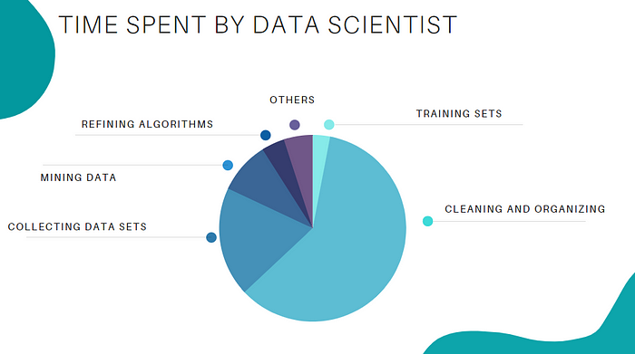
Importance Of Feature Engineering
Feature Engineering is a very important step in machine learning. Feature engineering refers to the process of designing artificial features into an algorithm. These artificial features are then used by that algorithm in order to improve its performance, or in other words reap better results. Data scientists spend most of their time with data, and it becomes important to make models accurate.

Slide 42
When feature engineering activities are done correctly, the resulting dataset is optimal and contains all of the important factors that affect the business problem. As a result of these datasets, the most accurate predictive models and the most useful insights are produced.
Feature Engineering Techniques for Machine Learning
Let’s see a few feature engineering best techniques that you can use. Some of the techniques listed may work better with certain algorithms or datasets, while others may be useful in all situations.
1.Imputation
When it comes to preparing your data for machine learning, missing values are one of the most typical issues. Human errors, data flow interruptions, privacy concerns, and other factors could all contribute to missing values. Missing values have an impact on the performance of machine learning models for whatever cause. The main goal of imputation is to handle these missing values. There are two types of imputation :

Slide 43
Numerical Imputation: To figure out what numbers should be assigned to people currently in the population, we usually use data from completed surveys or censuses. These data sets can include information about how many people eat different types of food, whether they live in a city or country with a cold climate, and how much they earn every year. That is why numerical imputation is used to fill gaps in surveys or censuses when certain pieces of information are missing.
Categorical Imputation: When dealing with categorical columns, replacing missing values with the highest value in the column is a smart solution. However, if you believe the values in the column are evenly distributed and there is no dominating value, imputing a category like “Other” would be a better choice, as your imputation is more likely to converge to a random selection in this scenario.

Slide 44
2. Handling Outliers
Outlier handling is a technique for removing outliers from a dataset. This method can be used on a variety of scales to produce a more accurate data representation. This has an impact on the model’s performance. Depending on the model, the effect could be large or minimal; for example, linear regression is particularly susceptible to outliers. This procedure should be completed prior to model training. The various methods of handling outliers include:
Removal: Outlier-containing entries are deleted from the distribution. However, if there are outliers across numerous variables, this strategy may result in a big chunk of the datasheet being missed.
Replacing values: Alternatively, the outliers could be handled as missing values and replaced with suitable imputation.
Capping: Using an arbitrary value or a value from a variable distribution to replace the maximum and minimum values.
Discretization : Discretization is the process of converting continuous variables, models, and functions into discrete ones. This is accomplished by constructing a series of continuous intervals (or bins) that span the range of our desired variable/model/function.

Slide 47
Feature Construction:
Definition: Feature construction involves creating new features from existing data. This can include mathematical combinations, transformations, or engineering new variables that provide additional information for the task at hand.
Purpose: Feature construction is used when the original data doesn't contain all the relevant information for the problem. By creating new features, you can potentially uncover hidden patterns or relationships that are valuable for analysis and modeling.
Feature Subset Selection:
Definition: Feature subset selection is the process of choosing a relevant subset of features from the original set while discarding irrelevant or redundant ones.
Purpose: This technique helps reduce the dimensionality of the data, which can lead to improved model performance, faster training, and better interpretability. It can also mitigate the risk of overfitting.

Slide 48
Feature Learning:
Definition: Feature learning, often achieved through deep learning methods, is the process of automatically discovering informative features from the raw data.
Purpose: Feature learning is especially useful when dealing with complex data or unstructured data like images, text, or speech. Deep learning algorithms can learn hierarchical representations of features directly from the data, reducing the need for manual feature engineering.

